Slide 1

Apache Spark
March 9, 2020

Slide 2
What is Spark?
Fast, general purpose computing engine for parallel data processing on clusters of computers
Runs on various cluster managers
YARN
Mesos
Kubernetes
Spark standalone
Languages supported
Scala
Python
Java
R
Notes:
Bullet Points

Slide 3
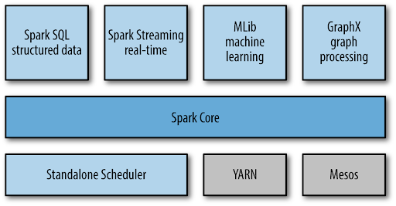
Components and Libraries
Notes:
Bullet Points

Slide 4
Spark Processes
Driver process
Controller of your Spark application
Responsible for asking cluster manager for resources and launching executors
Responsible for assigning tasks to executors
Monitors success or failure of executors
Executors:
Processes which run on data nodes inside your cluster
Responsible for receiving tasks from the driver process and executing them on their individual slices of the data
Report back success or failure to the driver
Notes:
Bullet Points

Slide 5
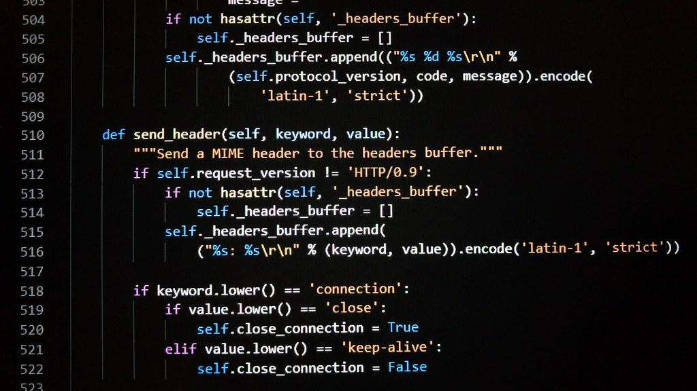
Execution Flow
Worker Node
Executor
Executor
CPU
CPU
CPU
CPU
D1
D4
D7
Worker Node
Driver Process
SparkContext or
SparkSession
Cluster Manager
Executor
Executor
CPU
CPU
CPU
CPU
D2
D5
D8
Cluster manager: Run my program with 6 executors with 2 CPUs each, please!
Worker Node
Executor
Executor
Your Spark program (Scala/Python/Java)
CPU
CPU
CPU
CPU
Edge Node
Data Nodes
D3
D6
D9
Notes:
Bullet Points

Slide 6
Spark APIs

Slide 7
Example Data
case class Employee(name: String, age: Int, dept: String)
Name | String | Dept
Alice | 25 | Data Engineering
Bob | 35 | Management
Charlie | 45 | Data Engineering
Notes:
Bullet Points

Slide 8
Spark's Data Structures
Reading data from a local file into a list:
Python
with (open('/tmp/people.txt')) as f:
content = f.readlines()
#type(content) = list
Scala
val content =
Source.fromFile("/tmp/people.txt").getLines.toList
//content : List[String]
Notes:
Bullet Points

Slide 9
High Level vs. Low Level APIs
case class Employee(name: String, age: Int, dept: String)
Name | String | Dept
Alice | 25 | Data Engineering
Bob | 35 | Management
Charlie | 45 | Data Engineering
Notes:
Bullet Points

Slide 10
High Level vs. Low Level APIs
case class Employee(name: String, age: Int, dept: String)
RDDs (low level API):
data.map(employee => {employee.dept -> (employee.age, 1)})
.reduceByKey{case ((a1, c1), (a2, c2)) => (a1 + a2, c1 + c2)}
.map{case (dept, (age, c)) => dept -> age / c }
Name | String | Dept
Alice | 25 | Data Engineering
Bob | 35 | Management
Charlie | 45 | Data Engineering
Notes:
Bullet Points

Slide 11
High Level vs. Low Level APIs
case class Employee(name: String, age: Int, dept: String)
RDDs (low level API):
data.map(employee => {employee.dept -> (employee.age, 1)})
.reduceByKey{case ((a1, c1), (a2, c2)) => (a1 + a2, c1 + c2)}
.map{case (dept, (age, c)) => dept -> age / c }
DataFrames/Datasets (High level API):
data.groupBy("dept").avg("age")
Name | String | Dept
Alice | 25 | Data Engineering
Bob | 35 | Management
Charlie | 45 | Data Engineering
Notes:
Bullet Points

Slide 12
Why would I ever use RDDs??
In general...you shouldn't!
Officially, they are first class citizens. (Unofficially, you are discouraged from using them.)
However, it's good to understand they exist, since under the hood, DataFrames and Datasets are abstractions on top of RDDs.
Caveat: There is some functionality that's only available via the low-level RDD API:
You need very tight control over how your data is partitioned across the cluster
You need to use Spark distributed shared variables like broadcast variables or accumulators
Notes:
Bullet Points

Slide 13
Spark's Data Structures
RDDs
DataFrames
Datasets
Notes:
Bullet Points

Slide 14
RDDs
RDDs - Primary API in Spark 1.0, still available in 2.0
Distributed collection of objects
Low level API functions only - “feels like” functional programming
val lines : RDD[String] = sc.textFile("file:///tmp/people.txt")
lines.foreach(println)
val header : String = lines.first()
val notHeader :RDD[String] = lines.filter(line=>line != header)
val peopleTokens : RDD[Array[String]] = notHeader.map(line=>line.split(","))
val namesAndDoubledAges :RDD[(String,Int)]=
peopleTokens.map(tokens=>(tokens(0), tokens(1).toInt))
namesAndDoubledAges.foreach(println)
Notes:
Bullet Points

Slide 15
Spark's Data Structures
RDDs
DataFrames
Datasets
Notes:
Bullet Points

Slide 16
DataFrames
DataFrames - introduced in Spark 2.0
“Collection” of Row objects which have a schema
Row objects "feel like" a database row
DataFrames "feel like" a table,
High level API functions - “feels like” writing SQL
Have a lot of memory management benefits and allows for better query optimization than RDDs
val linesDf = spark.read.option("header", true).option("inferSchema", true).csv("people.txt")
linesDf.printSchema
val namesAndDoubledAges = linesDf.select($"name", $"age"*2)
namesAndDoubledAges.foreach(row=>println(row))
Notes:
Bullet Points

Slide 17
Spark's Data Structures
RDDs
DataFrames
Datasets
Notes:
Bullet Points

Slide 18
Datasets
Datasets - introduced in Spark 2.0
Strongly typed
“Collection” of custom objects
High level API functions - “feels like” writing SQL
Only available in Scala/Java, since Python doesn't have static typing
case class Person(name: String, age: Int, dept: String) {
def prettyPrint() = {
println(s"Name is $name, age is $age, dept is $dept")
}
}
val peopleDf = spark.read.option("header", true).option("inferSchema", true).csv("people.txt")
val peopleDs = peopleDf.as[Person]
peopleDs.foreach(person=>person.prettyPrint())
Notes:
Bullet Points

Slide 19
Transformations vs. Actions

Slide 20
Transformations
Any operation that returns another RDD/DataFrame
Examples:
“Double each element in my RDD” => an RDD with every element doubled
“Read in a file and store its contents as an RDD” => an RDD containing the file’s contents
“Repartition my RDD from 200 partitions to 20” => an RDD with the same elements but fewer partitions
“Transform my RDD of words into a key-value pair using the first letter as key” => returns a key-value RDD
“Hello” becomes (“H” -> “Hello”)
Notes:
Bullet Points

Slide 21
Common Transformations
DataFrames/Datasets
select
filter
map
flatMap
join
groupBy
repartition
partitionBy
sortBy
withColumn
Notes:
Bullet Points

Slide 22
Actions
Any operation that doesn't return another RDD/DataFrame
Examples:
“Print data to the console” => prints data to the console, has no return value
“Save data to a file” => writes data to a file, has no return value
“Write data externally” => writes data somewhere else, has no return value
“Convert my RDD into a native object" (eg, RDD[Int] to Java Array of Ints) => returns a Java Array of Ints
Notes:
Bullet Points

Slide 23
Common Actions
foreach
write
count
reduce
collect
Notes:
Bullet Points

Slide 24
Transformations are lazy!
Spark will execute nothing when you declare a new transformation!
Only actions trigger execution
Spark maintains an execution graph that is updated with every new transformation
Actions kick off the built up graph
Spark program consists of:
Transformation 1 (Adds it to the DAG but executes nothing)
Transformation 2 (Adds it to the DAG but executes nothing)
Transformation 3 (Adds it to the DAG but executes nothing)
Action 1 (kicks off the entire DAG)
Transformation 1 (Adds it to a new DAG but executes nothing)
...
Notes:
Bullet Points

Slide 25
How many actions?
In the Spark program below, how many actions are there?
val linesDf=spark.read.option("header", true)
.option("inferSchema", true).csv("file:///tmp/people.txt")
val namesOnly = linesDf.select($"name")
val notTim = namesOnly.filter($"name" =!= "Tim")
notTim.foreach(name=>println(name))
val agesOnly = linesDf.select($"age" *2)
agesOnly.write.format("csv").save("/tmp/agesOnly")
println(agesOnly.count())
val maxAge = linesDf.agg(max("Age")).head
println(s"maxAge is $maxAge")
Notes:
Bullet Points

Slide 26
How many actions?
In the Spark program below, how many actions are there?
val linesDf=spark.read.option("header", true)
.option("inferSchema", true).csv("file:///tmp/people.txt")
val namesOnly = linesDf.select($"name")
val notTim = namesOnly.filter($"name" =!= "Tim")
notTim.foreach(name=>println(name))
val agesOnly = linesDf.select($"age" *2)
agesOnly.write.format("csv").save("/tmp/agesOnly")
println(agesOnly.count())
val maxAge = linesDf.agg(max("Age")).head
println(s"maxAge is $maxAge")
Notes:
Bullet Points

Slide 27
Useful Spark Functions

Slide 28
Running a Spark Program
spark-submit
spark-submit
--master yarn
--class com.mypackage.Main
--num-executors 200
My-jar-file.jar
Typically first line of program should be:
val spark: SparkSession = SparkSession.builder().getOrCreate()
spark-shell or pyspark
Automatic SparkSession available named "spark"
Notes:
Bullet Points

Slide 29
Reading input files
Scala:
spark.read.format("json").load("file:///path/to/some_file.json")
spark.read.option("inferSchema", true)
.option("header", true").csv("file:///path/to/some_file.csv")
Python:
spark.read.format("json").load("file:///path/to/some_file.json")
spark.read.option("inferSchema", True)
.option("header", True").csv("file:///path/to/some_file.csv")
Notes:
Bullet Points

Slide 30
printSchema
Display the schema for a DataFrame
df.printSchema()
Notes:
Bullet Points

Slide 31
SELECT
Select and manipulates columns in your DataFrame
df.select(col("name"), col("price"))
df.select(col("price")*2)
df.select(col("price")+5)
Python tip:
from pyspark.sql.functions import col
Notes:
Bullet Points

Slide 32
WHERE/FILTER
Scala:
df.filter(col("qty") > 100)
df.filter(col("name") =!= "Tim")
Python:
df.filter(col("qty") > 100)
df.filter(col("name") != "Tim")
Notes:
Bullet Points

Slide 33
Aggregations
Min/Max/Sum/Avg
df.select(min("price"), max("price"), sum("qty"), avg("qty")).head()
GroupBy
df.groupBy(col("price"), col("itemNumber")).count().head()
Notes:
Bullet Points

Slide 34
Sorting
Sort
df.sort(asc("qty")).head()
df.sort(desc("qty")).head()
Python tip:
from pyspark.sql.functions import asc, desc
Notes:
Bullet Points

Slide 35
Lab Time

Slide 36
Lab setup
git clone
https://github.com/1904labs/SparkScalaStarter
Or
https://github.com/1904labs/SparkPythonStarter
There are data sets under:
src/main/data (Scala)
data (Python)
Data sets:
population_data.json
Take a look at the schema for yourself!
Notes:
Bullet Points

Slide 37
Lab questions
Imports!!!
Scala: import org.apache.spark.sql.function._
Python: from pyspark.sql.functions import *
population_data.json
What is the latest year in the dataset?
How far back does this data go?
What was the largest country in the world in 1980? How big was its population?
This data set includes more than just country population data - it also includes income bands. How many income bands does it divide the world up into? (Hint: You will have to visually scan some data to determine the naming scheme they use for income bands. Try sorting on various columns until you find it…)
movie_ratings.csv
Look at the ratings for "Star Wars: Episode III - Revenge of the Sith". What is unusual about this dataset?
How can you handle this situation?
What is the best reviewed movie in this data set? What is the worst?
What is the best reviewed movie with "Home" in its title?
Notes:
Bullet Points

Slide 38
Next Week

Slide 39
Homework
https://spark.apache.org/docs/latest/structured-streaming-programming-guide.html
https://spark.apache.org/docs/latest/structured-streaming-kafka-integration.html
Optional: Spark Class: Section 8: Intro to Spark Streaming

